Slide 1
Round 1 Presentation
.Predict()
Team: 10
Project: .Predict()

Slide 2
Deep Neural Network Call Routing (Commercial)
Step One
Collect Data (IVR, Voice, Agent, Survey)
Step Two
Train and Test Network
Step Three
Plug Neural Network into GVP (Genesys Voice Platform)
Step Four
Profit!

Slide 3
Creativity- Originality
Does this solution consider a new problem and provide an original solution?

Slide 4
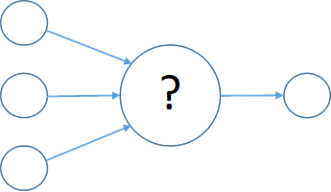

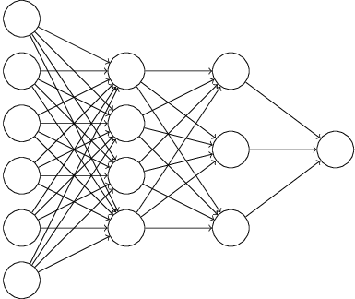

Classic Routing VS Deep Neural Network Routing
Classic Routing
Does not take real time action based on previous Days/Months/Years Events & Data
Takes no action to promote positive Net Promoter Score (NPS)
Does nothing to reduce Average Handle Time (AHT)
Creates a nearly random Client Experience (CX)
Deep Neural Network Routing (DNN)
Relearns everything it knows every day from any range of history so it may make the best possible decisions
Trained properly, DNN promotes positive NPS and lowers AHT
Creates intelligent and consistent CX

Slide 5
Creativity- Innovation
Does this solution introduce new technology, innovation, and/or an innovative approach?

Slide 6
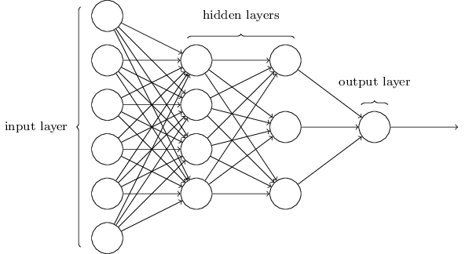
Deep Neural Networks (Data Science)
Regular Supervised and Unsupervised Training
DNNs re-train themselves hourly based on historical data to constantly remain relevant and accurate.
DNNs continue to remember old anomalies and their resolutions, while learning new solutions from new anomalies that present.
Inferencing takes only microseconds

Slide 7
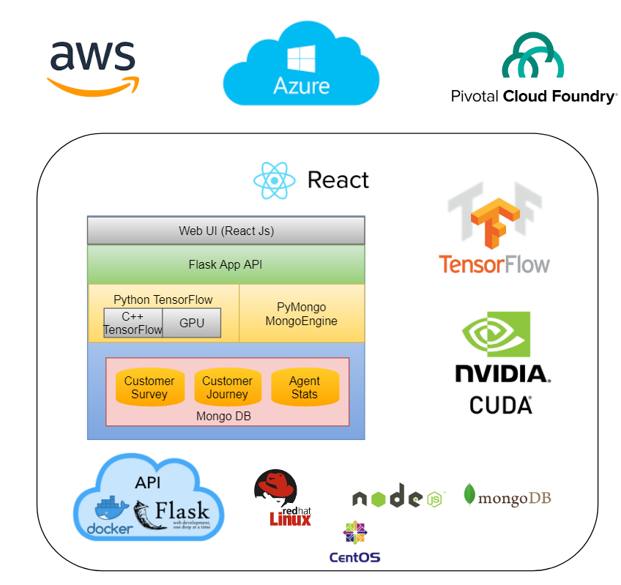
Containers (Cloud/On-Prem)
All packed up and ready to ship!
Docker Containerized with:
Python
Node/React
Tensorflow/Tensorboard
Can ship to:
PCF
AWS
Azure
VM
Etc…

Slide 8
Market- Client First
How does this product meet the needs of the client?

Slide 9
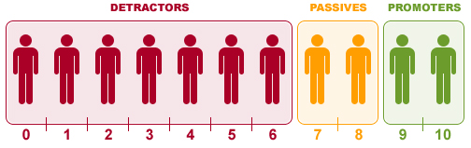
Contact Centers (Voice/SMS Interfaces)
Clients Purchase Contact Center Elevated Experience (C2E2) from First Data
Using the latest features available in Python 3/Tensorflow/Keras
Build a Deep Neural Network (DNN) conduct supervised training on:
The client experience and intent of existing IVR applications
The client experience and intent of agents
The NPS and survey results
Enables us to:
Predict NPS and AHT prior to routing the call to agents
Route those calls to the strategic target agent yielding improved CX and AHT

Slide 10
Market- Future Product
Is this product easy to bring to market and providing business value?

Slide 11
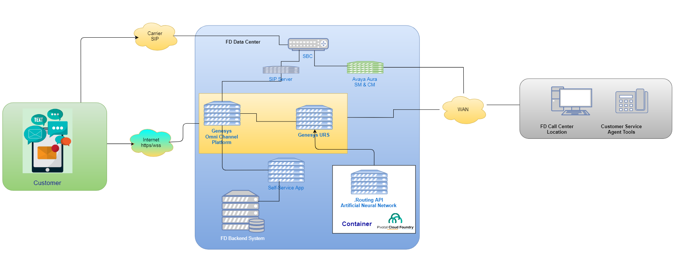
Plug, Train and Play
Appending this Solution to the end of existing IVR applications provide you with DNN features.

Slide 13
Round 2 Presentation
.Predict()
Team: 10
Project: .Predict()

Slide 14
Deep Neural Network Call Routing (Commercial)
Step One
Collect Data (IVR, Voice, Agent, Survey)
Step Two
Train and Test Network
Step Three
Plug Neural Network into GVP (Genesys Voice Platform)
Step Four
Profit!

Slide 15
Creativity- Originality
Does this solution consider a new problem and provide an original solution?

Slide 16
Classic Routing VS Deep Neural Network Routing
Classic Routing
Does not take real time action based on previous Days/Months/Years Events & Data
Takes no action to promote positive Net Promoter Score (NPS)
Does nothing to reduce Average Handle Time (AHT)
Creates a nearly random Client Experience (CX)
Deep Neural Network Routing (DNN)
Relearns everything it knows every day from any range of history so it may make the best possible decisions
Trained properly, DNN promotes positive NPS and lowers AHT
Creates intelligent and consistent CX

Slide 17
Creativity- Innovation
Does this solution introduce new technology, innovation, and/or an innovative approach?

Slide 18
Deep Neural Networks (Data Science)
Regular Supervised and Unsupervised Training
DNNs re-train themselves hourly based on historical data to constantly remain relevant and accurate.
DNNs continue to remember old anomalies and their resolutions, while learning new solutions from new anomalies that present.
Inferencing takes only microseconds

Slide 19
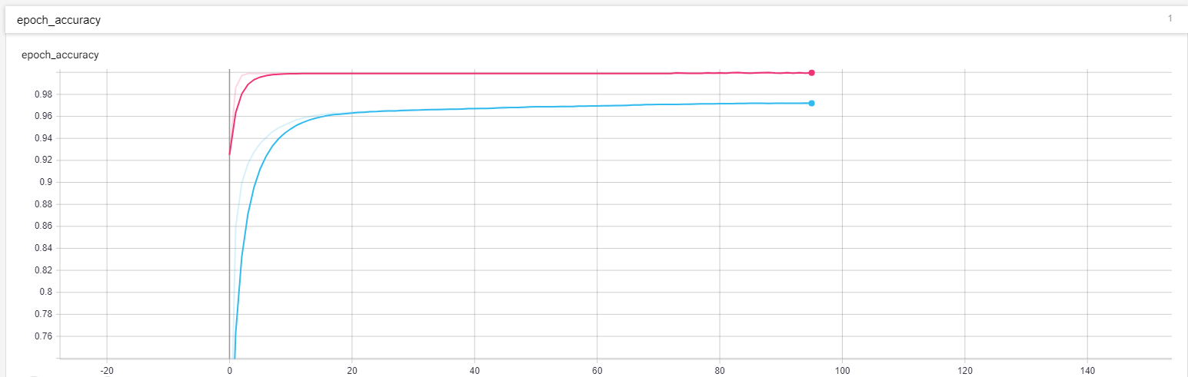
Training (Data Science)
Network Training (95 Epoch)
Pink = Testing Validation w/ Validation Data
Blue = Training Validation w/ Training Data

Slide 20
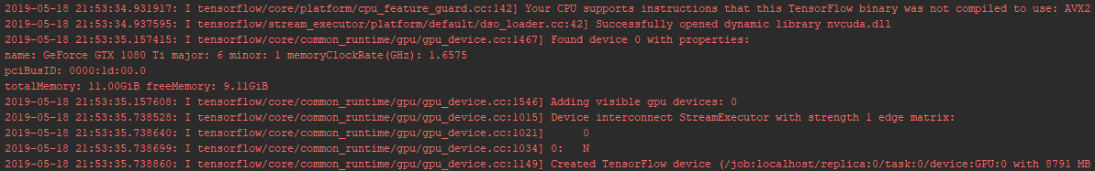
Training (Data Science)
Training on GTX 1080 Ti

Slide 21
Containers (Cloud/On-Prem)
All packed up and ready to ship!
Docker Containerized with:
Python
Node/React
Tensorflow/Tensorboard
Can ship to:
PCF
AWS
Azure
VM
Etc…

Slide 22
Market- Client First
How does this product meet the needs of the client?

Slide 23
Contact Centers (Voice/SMS Interfaces)
Clients Purchase Contact Center Elevated Experience (C2E2) from First Data
Using the latest features available in Python 3/Tensorflow/Keras
Build a Deep Neural Network (DNN) conduct supervised training on:
The client experience and intent of existing IVR applications
The client experience and intent of agents
The NPS and survey results
Enables us to:
Predict NPS and AHT prior to routing the call to agents
Route those calls to the strategic target agent yielding improved CX and AHT

Slide 24
Market- Future Product
Is this product easy to bring to market and providing business value?

Slide 25
Plug, Train and Play
Appending this Solution to the end of existing IVR applications provide you with DNN features.

Slide 27
Round 3 Presentation
.Predict()
Team: 10
Project: .Predict()

Slide 28
Deep Neural Network Call Routing (Commercial)
Step One
Collect Data (IVR, Voice, Agent, Survey)
Step Two
Train and Test Network
Step Three
Plug Neural Network into GVP (Genesys Voice Platform)
Step Four
Profit!

Slide 29
Creativity- Originality
Does this solution consider a new problem and provide an original solution?

Slide 30
Classic Routing VS Deep Neural Network Routing
Classic Routing
Does not take real time action based on previous Days/Months/Years Events & Data
Takes no action to promote positive Net Promoter Score (NPS)
Does nothing to reduce Average Handle Time (AHT)
Creates a nearly random Client Experience (CX)
Deep Neural Network Routing (DNN)
Relearns everything it knows every day from any range of history so it may make the best possible decisions
Trained properly, DNN promotes positive NPS and lowers AHT
Creates intelligent and consistent CX

Slide 31
Creativity- Innovation
Does this solution introduce new technology, innovation, and/or an innovative approach?

Slide 32
Deep Neural Networks (Data Science)
Regular Supervised and Unsupervised Training
DNNs re-train themselves hourly based on historical data to constantly remain relevant and accurate.
DNNs continue to remember old anomalies and their resolutions, while learning new solutions from new anomalies that present.
Inferencing takes only microseconds

Slide 33
Containers (Cloud/On-Prem)
All packed up and ready to ship!
Docker Containerized with:
Python
Node/React
Tensorflow/Tensorboard
Can ship to:
PCF
AWS
Azure
VM
Etc…

Slide 34
Market- Client First
How does this product meet the needs of the client?

Slide 35
Contact Centers (Voice/SMS Interfaces)
Clients Purchase Contact Center Elevated Experience (C2E2) from First Data
Using the latest features available in Python 3/Tensorflow/Keras
Build a Deep Neural Network (DNN) conduct supervised training on:
The client experience and intent of existing IVR applications
The client experience and intent of agents
The NPS and survey results
Enables us to:
Predict NPS and AHT prior to routing the call to agents
Route those calls to the strategic target agent yielding improved CX and AHT

Slide 36
Market- Future Product
Is this product easy to bring to market and providing business value?

Slide 37
Plug, Train and Play
Appending this Solution to the end of existing IVR applications provide you with DNN features.

Slide 39
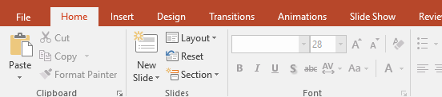
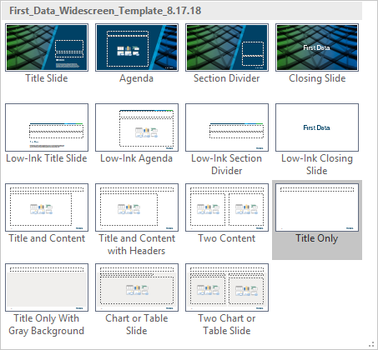
Alternative slide layouts
This template contains Title, Section Divider, Agenda, and Closing Slide layouts that are designed to print with very little ink.
To use these options, follow these steps:
Got to the slide you wish to change
Go to the Home tab on the PowerPoint Ribbon and click Layout (1)
From the drop-down menu select the appropriate Low-Ink slide layout from the thumbnail images (2)
1
2

Slide 40
Simple bulleted text
Bulleted text level 1
Bulleted text level 2
Bulleted text level 3

Slide 41
Bulleted text with headers
Text level one for (header without bullet)
Press Enter then Tab and start typing for bulleted text
Bulleted text (level two)
Press Enter then Tab for a sub-bullet (level three)
Sub-bullet (level three)
Press Enter then Shift + Tab to return to level one for a new header
Press Enter then Tab and start typing for bulleted text
Bulleted text (level two)

Slide 42
Text formatting notes
If you wish to have a subtitle, enter it as the first line in content placeholder
Titles are in sentence case (capitalize just as you would a sentence)
Column headers are in title case (see the example on next slide)
Many sales decks employ title formatting similar to above
This is achieved by selecting a few words and changing the font to Arial Black
Do not place periods at the end of bulleted text
If a bullet contains more than one sentence, then punctuation is required. This is demonstrated in this bullet point. It is preferable to treat this text as a paragraph with no bullet, if possible.
Bullet specs: Alt 155 – Arial Black, 150%¹
If you need to footnote an item, use a superscript numeral like this²
Source: This is an example of formatting for a source that applies to an entire slide. If you have multiple sources on a slide, you can add a 8 pt. label underneath tables and charts or use a superscript and footnote for references in text (example below).
Source: Source name.
This is an example of a footnote and corresponds to the superscript numeral on the last bullet point.

Slide 43
Two-column layout
Text Level One
Use title case for column headers
Use AP Style for title case
Capitalize all nouns, pronouns, verbs (including is, are, was, be), adjectives, and adverbs
Do not capitalize articles, prepositions, or coordinating conjunctions of three letters or less (examples: a, an, the, at, by, for, in, of, on, to, up, and, as, but, or, and nor)
Capitalize prepositions of four letters or more (examples: From, With, Without, Between, Among)
Text Level One
Press Enter then Tab and start typing for bulleted text
Press Enter then Tab and start typing for bulleted text
Bulleted text (level 3)
Bulleted text (level 3)

Slide 44
Column chart
Chart Title ($ M)¹
If you need to abbreviate thousands, million, billion, and trillions, use K, M, B, and T.

Slide 45
Stacked column chart
Chart Title (units)
Footnote

Slide 46
Bar chart
Chart Title (units)
Footnote

Slide 47
Line chart
Chart Title (units)
Footnote

Slide 48
Doughnut chart
Chart Title (units)
Total Label
(if needed)
Footnote

Slide 49
Layout with two charts
Chart Title (units)
Chart Title (units)
Source: If you have multiple charts or tables you may label the source underneath the item
Source: If you have multiple charts or tables you may label the source underneath the item
Footnote

Slide 50
Table example
Table Title (units)
 | Right-align | Right-align | Center | Left-align
Rows are top aligned | 100.00 | 12 | Yes | Left-align text columns such as notes columns. You may need to add additional spacing to the left margin of these cells.
Expense at PYRR | 1,000.00 | 1 | No | Right-align numeric columns
EBITDA at PYRR | 10,000.00 | 1,584 | Yes | Center-align columns with icons, or limited text such as “Yes” or “No”
Total Row | 100.00 | 3 | No
Table lines are .75pts, RGB = 182, 173, 165
Footnote

Slide 51
Table example with bullet points
Table Title (units)
 | Notes on Bullet Point Format
Custom Chevron Bullet Point | By default, bullet points in template placeholders are formatted automatically If you create a new text box, before typing, press Tab twice to generate bullet point
Manual Bullet Point Formatting | In some cases you may need to apply the bullet manually Find at least two correctly formatted bullet points elsewhere in your presentation Click-drag to select the text in both bullet points and press Ctrl +Shift + C Select the text to which you wish to apply bullet and press Ctrl + Shift + V
Bullet Specifications | Bullet font is Arial Black Size is 130% Color is Blue, Accent 1
Footnote

Slide 52
Slide layout guidelines
5.95"
2.47"
Aside from slide title, optional header, and footnotes, all slide content (i.e., text, charts, and graphics) should fall within this red rectangle.
3.15"
Footnote

Slide 53
Background guidelines
For general purpose presentations, background elements (i.e., color panels, treated photos) may be placed anywhere between the horizontal red lines and may extend through the margin and all the way to the edge on the left or right. You also have the option of not using background elements (plain white background).
Background items that extend to the top or bottom of the slide (example to the right), are allowed, but keep in mind these require placement of logo on individual slides and are more difficult to maintain. Use sparingly.
Footnote

Slide 54
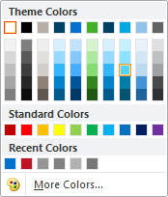
Color scheme
Dark Blue
Blue
Green
Turquoise
Light Blue
Gray
R: 0
G: 65
B: 101
R: 0
G: 114
B: 206
R: 67
G: 176
B: 42
R: 0
G: 169
B: 224
R: 146
G: 193
B: 233
R: 97
G: 99
B: 101
Secondary colors
These must be entered manually, and are for special cases such as charts and visualizations that require these colors.
Header color
Bullet
Yellow
Orange
Red
If you create a header or bullet on a dark blue background, ensure maximum contrast by using Accent 4, 40% lighter.
R: 255
G: 209
B: 0
R: 251
G: 79
B: 20
R: 192
G: 19
B: 36
Footnote

Slide 55
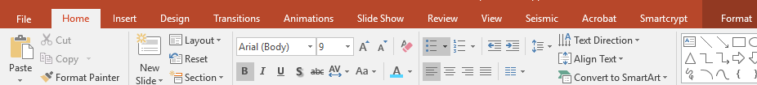
Text formatting tips
Try this: Insert a new text box and start typing: This is header text.
Now press Enter then Tab – this is second-level text. Use this for a second level of headers, or a bold introductory paragraph like this one.
Press Enter then Tab again
This is the third level of text: bullet point
Press Enter then Tab again for a second level bullet
Press Enter and Shift + Tab three times to return to level one
You can also use the Increase/Decrease List Level buttons to change text level
If you want a paragraph format like this where you express your thoughts in complete sentences, use the bullet point level and set bullet points to “None”.
Home tab
Press this to remove bullet for paragraph text
Increase/decrease list level
Insert text box
Click and drag to insert a box of a specific size with text wrapping within the width of the box

Slide 56
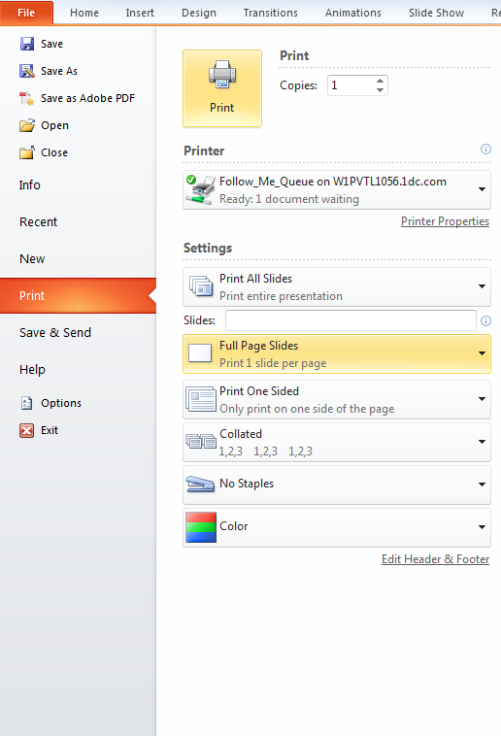
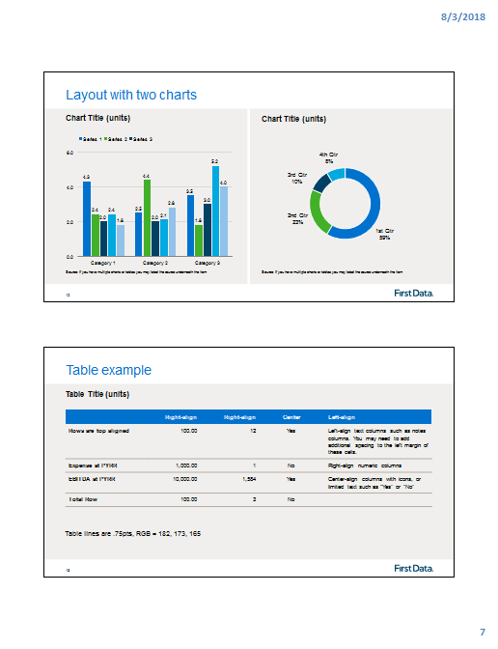
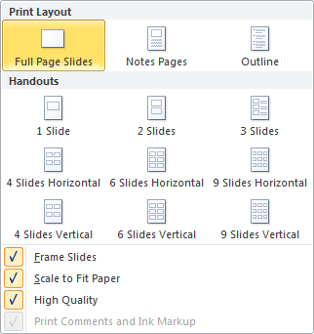
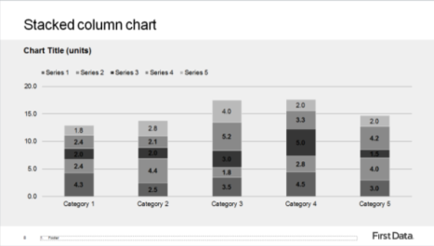
Printing
Before printing, check these settings in the PowerPoint Print menu:
Click the drop-down list (1) to select the type of print
When printing Full Page Slides (2) check the following settings (3):
Frame Slides This will add an outline around your slide.
Scale to Fit Paper Ensures that your slides fit on the page.
High Quality If you are having problems with transparent objects printing correctly, make sure this setting is checked.
More printing tips
Handouts (4 and 5) are very useful: Two slides fit neatly on one page while printing with half the paper and a fraction of the ink.
If you are printing on a black and white printer, you may find that some material is difficult to read (6). To avoid this, choose Color in the print menu (even though you are printing to a black and white printer).
5
1
2
6
4
3
Footnote

Slide 57

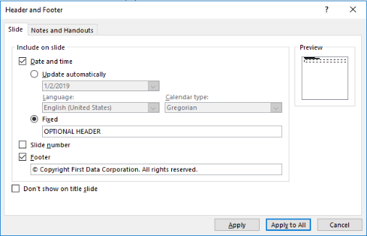
Headers and footnotes
To add a footnote to a slide:
Copy the footnote text box below (or any other footnote text box in this template)
Got to the slide where you need a text box
Paste text box and edit text as needed
The footnote text box is specially formatted so that it spans the entire width of slide but the text will not cover the page number or logo
If you find a footnote that is not placed correctly, repositioning is easy since the footnote text box snaps to the bottom, left, and right of the slide
Optional fields
There are two special text fields for adding text to your presentation such as “DRAFT”, “CONFIDENTIAL”, or a copyright statement for every slide (Note: template already contains copyright statement on cover).
To add either field:
Go to the Insert tab on the PowerPoint Ribbon (1) and click Header & Footer (2)
For optional header, check the “Date and time” checkbox (3), select Fixed, and type your text into the field immediate below (4)
For copyright statement, check the Footer checkbox (5) and the statement below should read: “© Copyright <year> First Data Corporation. All rights reserved.”
Click Apply to All to apply to every slide in presentation, or Apply to apply to just one slide (6)
1
2
3
4
5
6
Footnote
Each time you press enter for a new note, the box will automatically increase in height to accommodate.

